Slide 1
“STUDY OF EFFECTIVENESS OF TRAINING AND DEVELOPMENT WITH SPECIAL REFERENCE TO VEEKESY POLYMERS PVT LTD”

Slide 2
INTRODUCTION
Human Resource is most important asset of an organization. Training and Development is considered to be most important part of an organization.
“A study on the effectiveness of training and development with special reference to M/s. VEEKESY POLYMERS PVT LTD. Calicut” will be helpful in analyzing the effectiveness of training .
The study uses a questionnaire prepared for evaluating various factors which affect the effectiveness of training and the results are displayed in a table and graph format.

Slide 3
BACKGROUND
Knowledge- It helps a trainee to know facts, policies, procedures and rules pertaining to his job.
Skills-It helps him to increase his technical and manual efficiency necessary to do the job.
Attitude- It moulds his behavior towards his co-workers and supervisors and creates a sense of responsibility in the trainee.

Slide 4
NEED AND SCOPE OF THE STUDY
This study can be used as a tool to develop training method for M/s.VEEKESY POLYMERS PVT LTD.
The efficient working of an organization depends upon efficiency or capability of personnel working in an organization.
The purpose of training is to achieve a change in behavior of those trained and to enable them to do their job better in order to achieve this objective.

Slide 5
OBJECTIVES OF THE STUDY
To asses the effectiveness of training at M/s. VEEKESY POLYMERS PVT LTD .
To analyze whether employees are satisfied with various training programs implemented by the organization.
Identify whether employees need further training.

Slide 6
RESEARCH METHODOLOGY
Sample Design
Sample Size
Universe may be finite or infinite. The universe in this project is finite. The population involved in this project is employees of M/s.VEEKESY POLYMERS PVT LTD.
This refers to the number of items to be selected from the universe to constitute a sample size. In this research the sample size constitute 50 employees in the M/s.VEEKESY POLYMERS PVT LTD. organization.

Slide 7
METHODS
Sampling technique
Research Design
Simple random sampling technique is to be used in this project.
This project is based on descriptive research design.

Slide 8
Primary Data & Secondary Data
The study is based on primary data to be collected through structured questionnaires and personal interviews.
The data regarding company profile industry profile are collected from office records and internet.

Slide 9
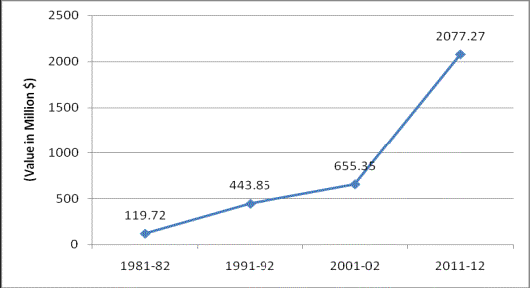
Chart showing Export Growth of footwears

Slide 10
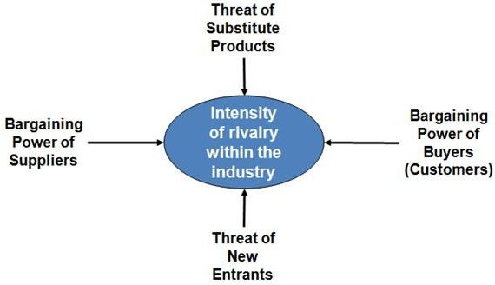
Porters 5 Forces Model

Slide 11
SUCCESS FACTORS OF THE FIRM
Foreign Technologies
Good Employer-Employee Relations
Quality of the Product
Advertising and Marketing

Slide 12
HRM MODEL
Training and Development
Organization Development
Organization/Job design
Human Resource planning
Selection and Staffing

Slide 13
TRAINING AND DEVELOPMENT
Knowledge- It helps a trainee to know facts, policies, procedures and rules pertaining to his job.
Skills-It helps him to increase his technical and manual efficiency necessary to do the job and
Attitude- It moulds his behavior towards his co-workers and supervisors and creates a sense of responsibility in the trainee.

Slide 14
Tools for Data Analysis
For analysis and interpretation of primary data percentage analysis is to be used mainly due to qualitative nature of data and bar diagram are to be used to represent them in pictorial form.

Slide 15
Identifying training needs
Organizational Analysis:
It involves a study of the entire organization in terms of its objectives, its resources, resource allocation and utilization, growth potential and its environment.

Slide 16
Systematic approach to training
Identifying training
Setting training objectives and policy
Designing training
Conduction

Slide 17
Task role / Operational Analysis
It is systematic and detailed analysis of jobs to identify job contents, the knowledge, skills and aptitudes required and the work behavior. Attention is paid to tasks to be performed, methods used, the way employees have learnt these techniques and performance standards required is analyzed in this stage. The purpose of operation analysis is to decide what should be taught.

Slide 18
GENDER OF RESPONDENTS
Gender of Respondents in %
Opinion | No. of Respondents | Percentage of Respondents
Male | 32 | 64
Female | 18 | 36
Total | 50 | 100
36 %
Female
Male
64 %
Male
Female

Slide 19
FEEDBACK ON PERFORMANCE AFETR ATTENDING TRAINING
Table 5.24: Table showing the feedback on improving performance after training
Source: Primary Data
Particulars | No of Respondents | Percentage of Respondents
Strongly Agree | 15 | 30
Agree | 23 | 46
Partially Agree | 12 | 24
Disagree | 0 | 0
Highly disagree | 0 | 0
Total | 50 | 100

Slide 20
Graph
Graph of Respondents
50
45
40
35
30
25
20
15
10
5
0
% of Respondents
Strongly Agree Agree Partially Agree Disagree Highly disagree

Slide 21
Conclusion
The training and development program adopted in M/s.VEEKESY POLYMERS PVT LTD. mainly concentrated on areas like quality aspects, job oriented trainings, technical skills and knowledge.
Most of the respondents rated as good and excellent towards the overall quality and effectiveness of the training and development programs and satisfied with the present training methods.
Finally the training and development programs provided by M/s.VEEKESY POLYMERS PVT LTD are found to be effective, credible and commendable, which can be improved further.

Slide 22
Thank you

